Slide 1
Chennai – India 14 December 2019

Slide 2
Intro to MLOps
@Chennai
Bhavani Ravi
@geeky_bhavani

Slide 3


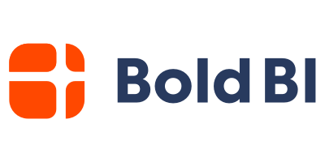



Slide 4
Who Am I?
Research Engineer - Saama
WomentechMakers Chennai
Build2Learn
Code * Community * Coffee bhavaniravi.com

Slide 5
Intro to MLOps

Slide 6
Why Should You Care?
85% of AI never reach production
10 years of software Development Practices is not helping ML much
Moving Beyond Kaggle
Best Practices are not arrived in harmony
Notes:
Start with a bunch of facts, Production level machine learning is as hard as finding a blog about one. Most ML still lives in jupyter notebook and kaggle. Software Engineering practices are often dumped upon ML engineers.

Slide 7
ML
Ops
Data Discovery
Preprocessing
Model Training
Model Prediction
Continuous Integration
Scaling
Observability
Reduce Costs
Software Engineering?
Notes:
What? - When we look at ML it is not tradional SE, infact it’s job becomes so minimal backed up with lot of guidelines and best practices. Same holds for Ops, but ML still has a missing piece

Slide 8
Why Now?

Slide 9
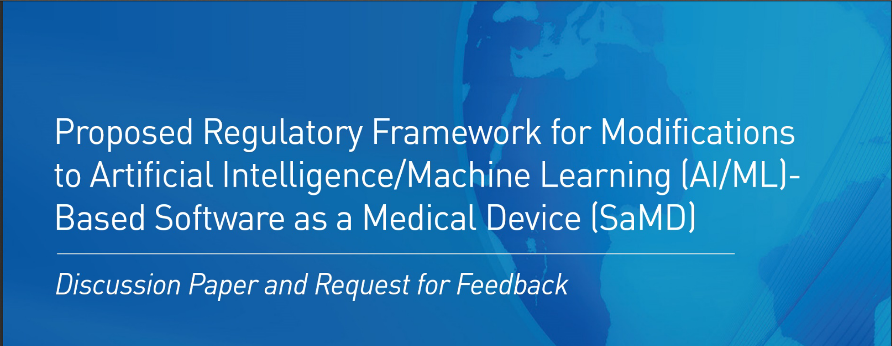
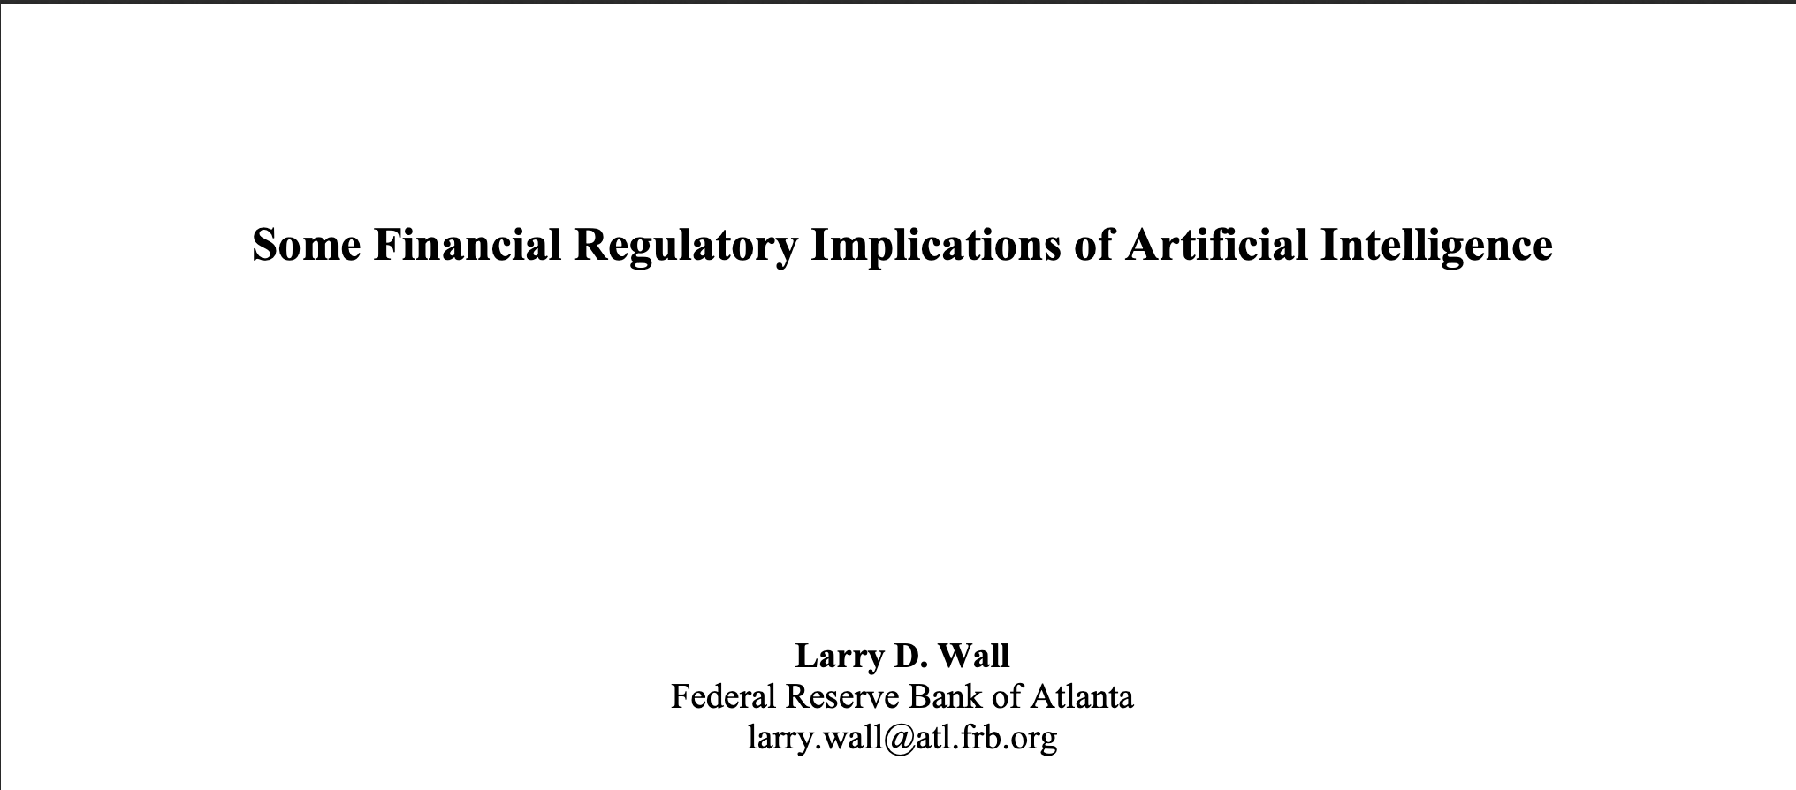

Notes:
Regulations by authorities if you are using ML in production

Slide 10
But really, Why?

Slide 11
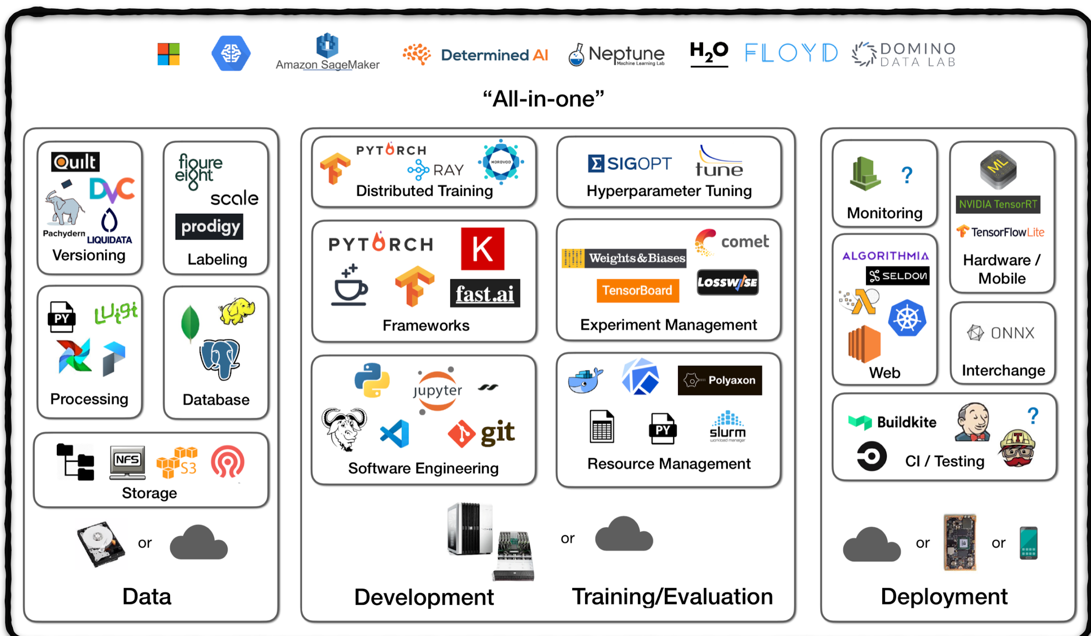
The ML EcoSystem
Notes:
We have enough tools but, we often hear

Slide 12
Model is training. Oh Wait! The environment crashed.

Slide 13
I wrote a model 6 months back. I don’t know where it is.

Slide 14
The app is running but the csv files are not there anymore.

Slide 15
I got 80% accuracy yesterday. I swear.
Notes:
Wait at this point I am way too partial and hard on ML engineers but here is the only thing systems people say.

Slide 16
It’s not working.
Notes:
Let that sink in for a moment

Slide 17
The ML EcoSystem
Notes:
We have enough tools

Slide 18
What’s missing though?

Slide 19
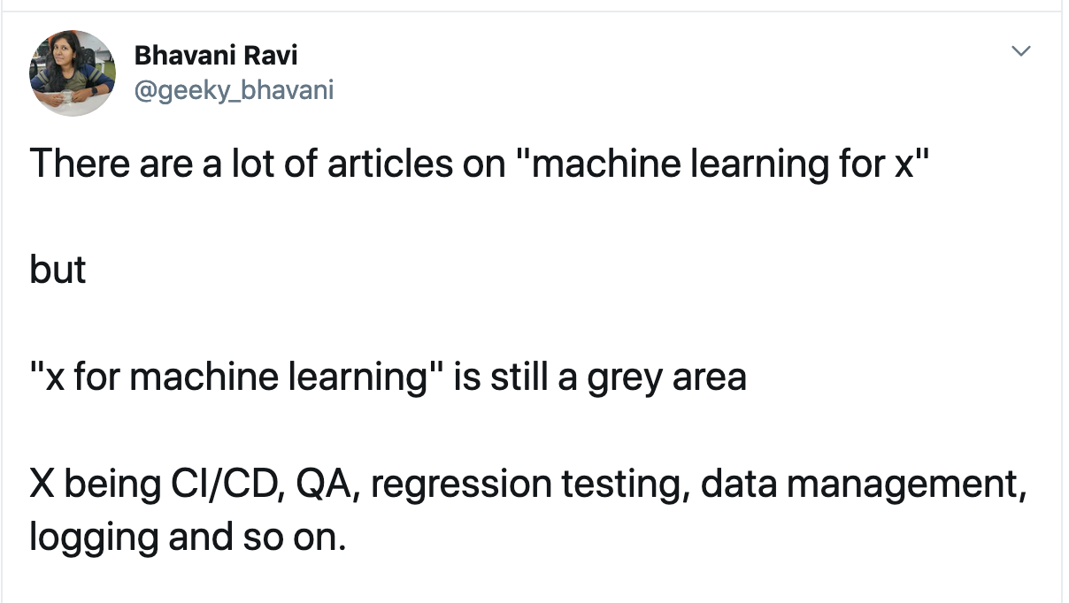
Notes:
Let that sink in for a moment

Slide 20
Let’s Take an Example Tweet Classifier

Slide 21
Tweet Classifier
Example
ML Engineer
Creates dataset
Preprocess them
Experiment with different models
Provides the one with best score for deployment
Software Engineer
User Interface
Wraps models into Rest APIs
Testing
Ops
Deployment
Scaling
Notes:
As an experimnent

Slide 22
Tweet Classifier
Use Cases
Running a batch process to fetch new tweets and make predictions.
Checking if the model’s working with production data.
Tweaking the model for new data
Fixing bugs or adding feature to the app
Test the changes
Move the changes to production
Notes:
But in production

Slide 23
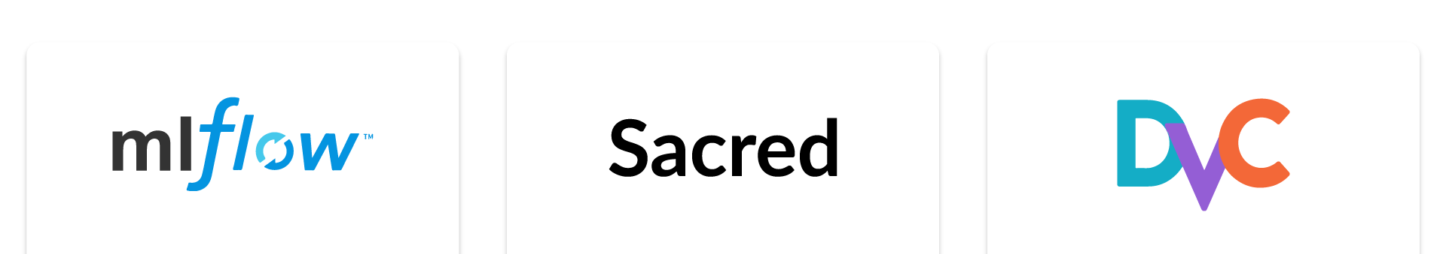
Data/Model Management
Versioning
Reproducibility
Experiment Tracking
Notes:
Let’s say the engineer leaves the company
Knowing what not to do is more important
Experiment tracking

Slide 24


Workflow Management
Data pipelines
Retraining the model
Asynchronous task execution
Notes:
Run batch process

Slide 25
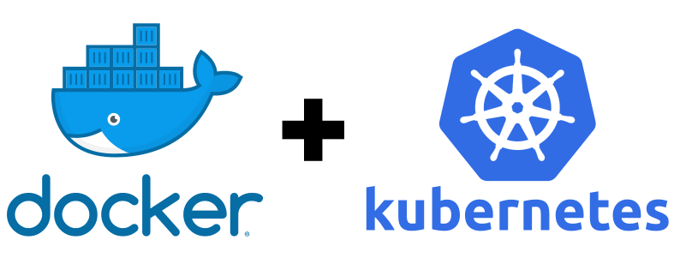
Deployment & Scaling
Portable
Auto scaling

Slide 26
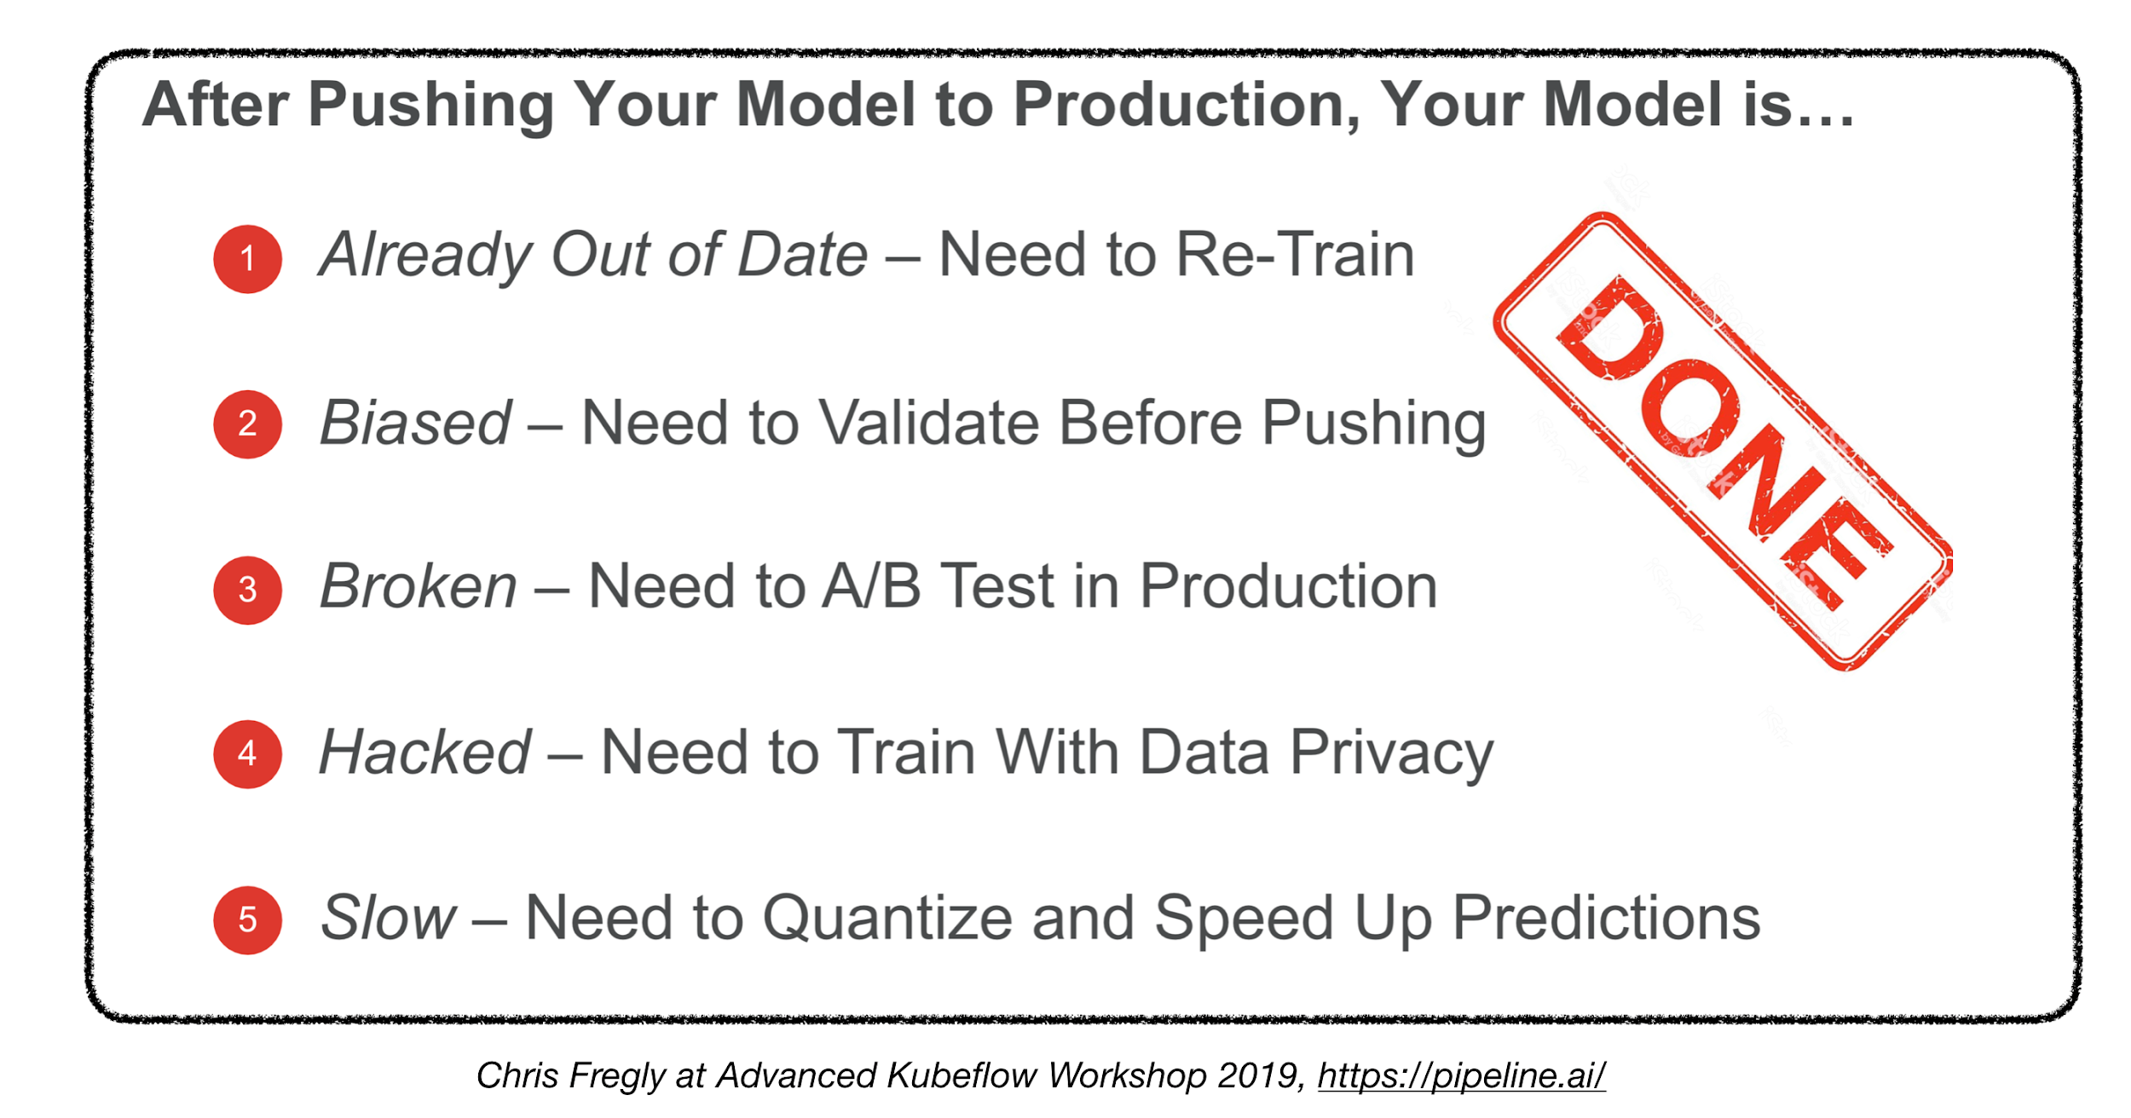

Slide 27
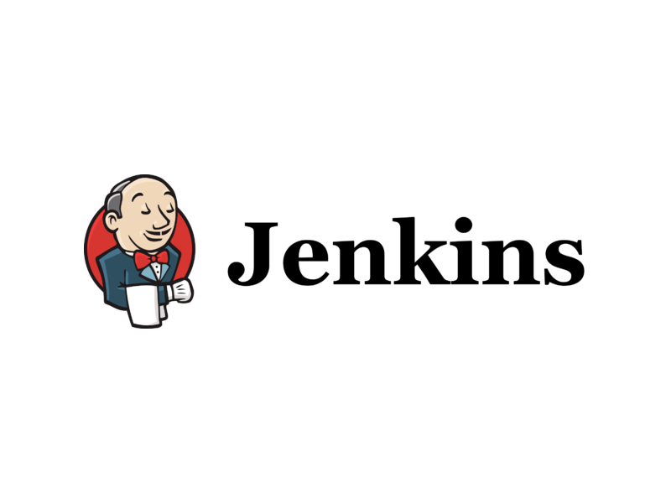
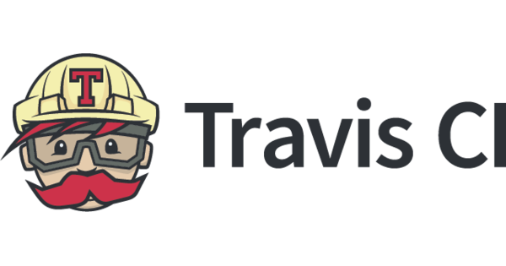
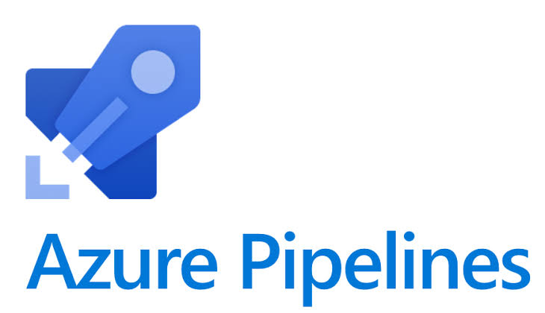
Continuous Integration
Update Production when
When model changes
When Service changes
When UI Changes

Slide 28
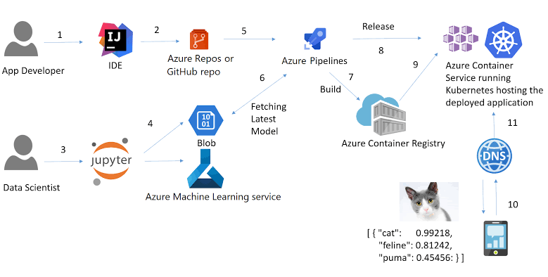
Continuous Integration - Workflow

Slide 29
UnExplored Area = More Opportunities

Slide 30
Any Questions?

Slide 31


